Slide 1

Predicting Loan Default for Small Businesses

Slide 2

The Dataset
The "SBAnational.csv" dataset, derived from the U.S. Small Business Administration (SBA), encapsulates historical records ranging from 1962 to 2014. It encompasses 27 columns and an extensive total of 899,164 observations.
Our project will focus on the subset of data spanning from 2008 to 2014, which comprises 96,845 rows.
Each row in the dataset represents a unique loan application. The dataset includes essential information about the borrowers and loans.

Slide 3

The Business Problem
Minimizing default risks for small businesses in loan guarantee processes by accurately predicting the likelihood of a "CHGOFF" (charged off) status in loan applications through the use of predictive analytics.

Slide 4

Our Goal
Accurately predicting the likelihood of a "CHGOFF" (charged off) status in loan applications. Leveraging predictive analytics on the "SBAnational.csv" dataset, we aim to make well-informed decisions as a guarantor company, proactively managing and mitigating associated financial risks to ensure the stability of both small businesses and lending institutions.
Develop a model that can predict whether a new loan application is likely to result in a "CHGOFF" (charged off) status

Slide 5

Exploration of Data

Slide 6
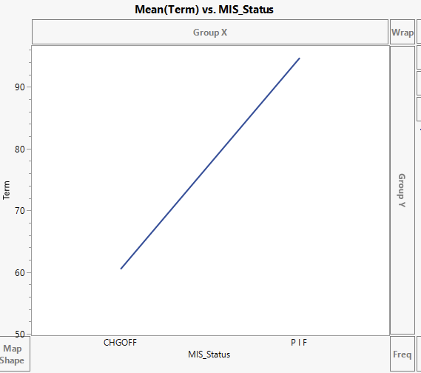
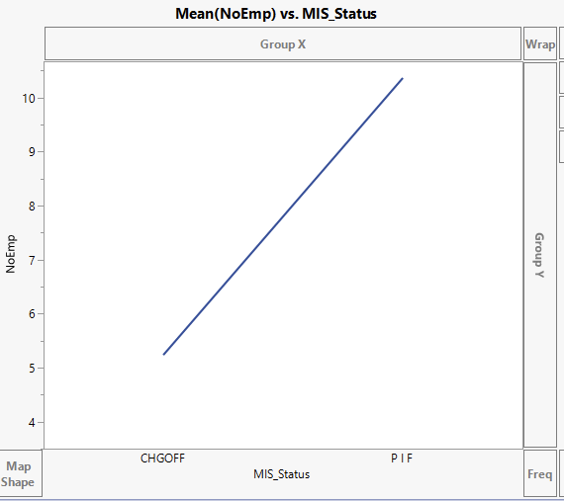
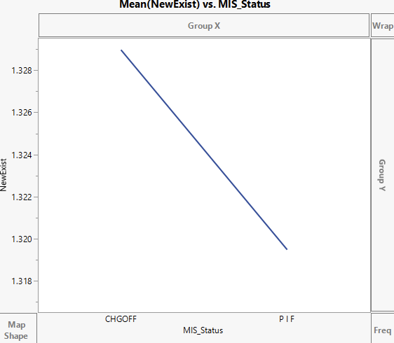
Important Variables
Column Name | Reasoning
MIS_Status | (Target Variable) This variable represents the loan status and can have one of two values, "CHGOFF" for charged off (indicating default) or "PIF" for paid in full
Term | Correlation (TV) longer loan terms are correlated with a lower rate of charge offs.
NoEmp | “MIS_Status” & the number of employees of a particular debtor (correlation)
NewExist | The newer the business the lower the charge off rate.

Slide 7
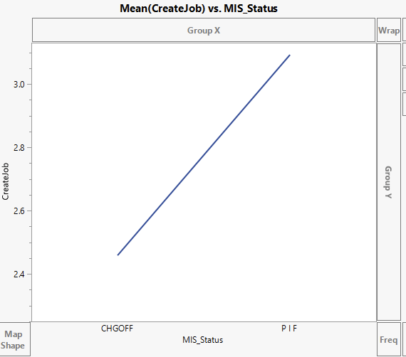
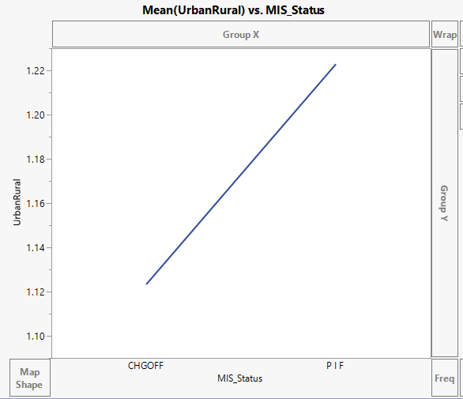
Important Variables (Continued)
Column Name | Reasoning
CreateJob | The more jobs that a loan is expected to create, the greater the likelihood that the loan will be paid in full. For simplicity, we have created a new column with 1 if any jobs were created, 0 otherwise.
UrbanRural | There is a correlation between borrower location (urban or rural) and MIS_Status.

Slide 8
Important Variables (Continued)
Column Name | Reasoning
NAICS | This new column represents the first two identifiers that classify what type of business industry.
LowDoc | It specifies if the borrower is part of the LowDoc Loan Program. (Loan approval with minimum or no documents)

Slide 9
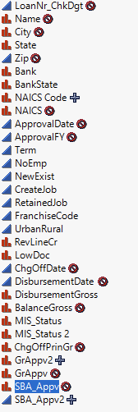
Variables Removed
Our data set contained columns that can result only after a loan is classified as CHGOFF. Though these columns can be very good predictors for model building, we have chosen not to consider them as we will not have data in these columns when deciding loan approval.
We have also removed columns that contained (1) pure identifiers (e.g., Name) and (2) time-stamp data (e.g., Approval Date) as those are not relevant for model building.

Slide 10
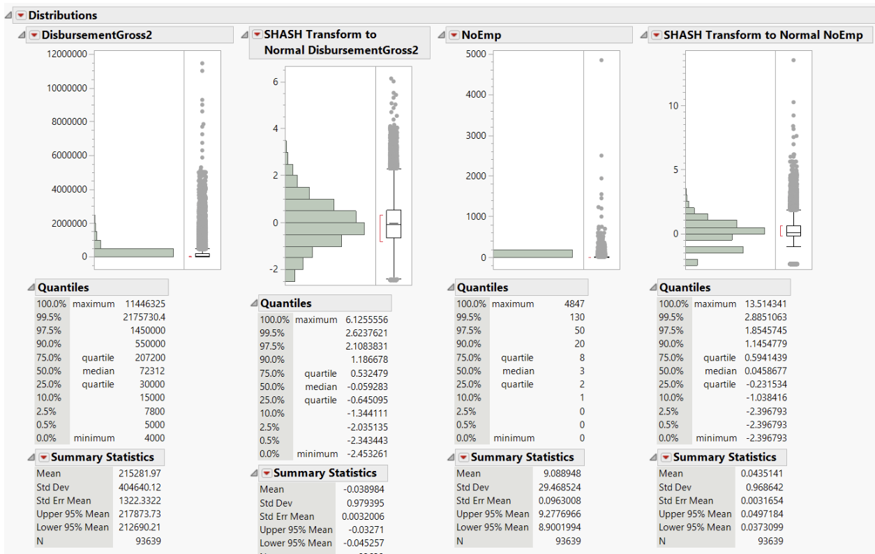
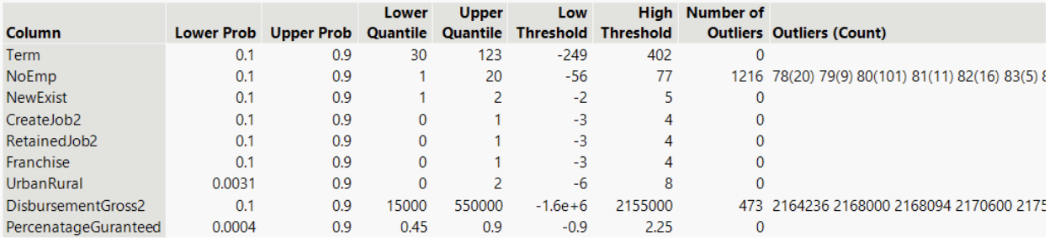
Outliers
Transformed columns rather than removing outliers was driven by the need to retain valuable data.

Slide 11
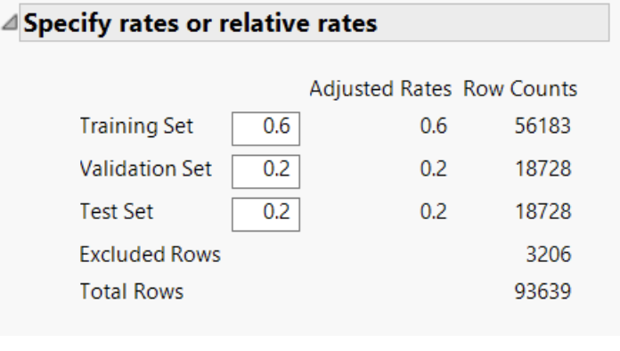
Data Partition
Partitioned the data into training, validation and testing with a 60:20:20 ratio.
Enabled a more reliable and accurate evaluation of the model's effectiveness in predicting loan approval outcomes for small businesses

Slide 12
Models for our Target (categorical) variable
KNN Model
Neural
Naïve
Decision Tree
Discriminant
Logistic Regression
Boosted Tree
Boot Strap

Slide 13
Model Performance: Comparision
Model Name | Total Accuracy | Accuracy of the 1 Prediction | Lift (Top 30%) | AUC
 |  |  |  | Training | Validation | Test
Logistic Regression Model | 85.64 | 80.67 | 2.5 | .8999 | .8638 | .8588
Decision Tree Model | 98.29 | 86.27 | 3.0 | 0.9702 | 0.9363 | 0.9338
Neural Network Model | 87.88 | 70.23 | 2.6 | 0.9397 | 0.9036 | 0.8997
Discriminant Model | 67.2 | 40.42 |  | 0.7468
KNN Model | 83.2 | 78.23 |  | 0.9397 | 0.9036 | 0.8997
Naïve Bayes Model | 74.9 | 66.62 | 2.2 | 0.8151 | 0.792 | 0.7884
Bootstrap Forest Model | 97.08 | 92.8 | 3.0 | 0.9853 | 0.9651 | 0.9647
Boosted Tree Model | 93.52 | 90.26 | 3.2 | 0.9852 | 0.9759 | 0.9757

Slide 14
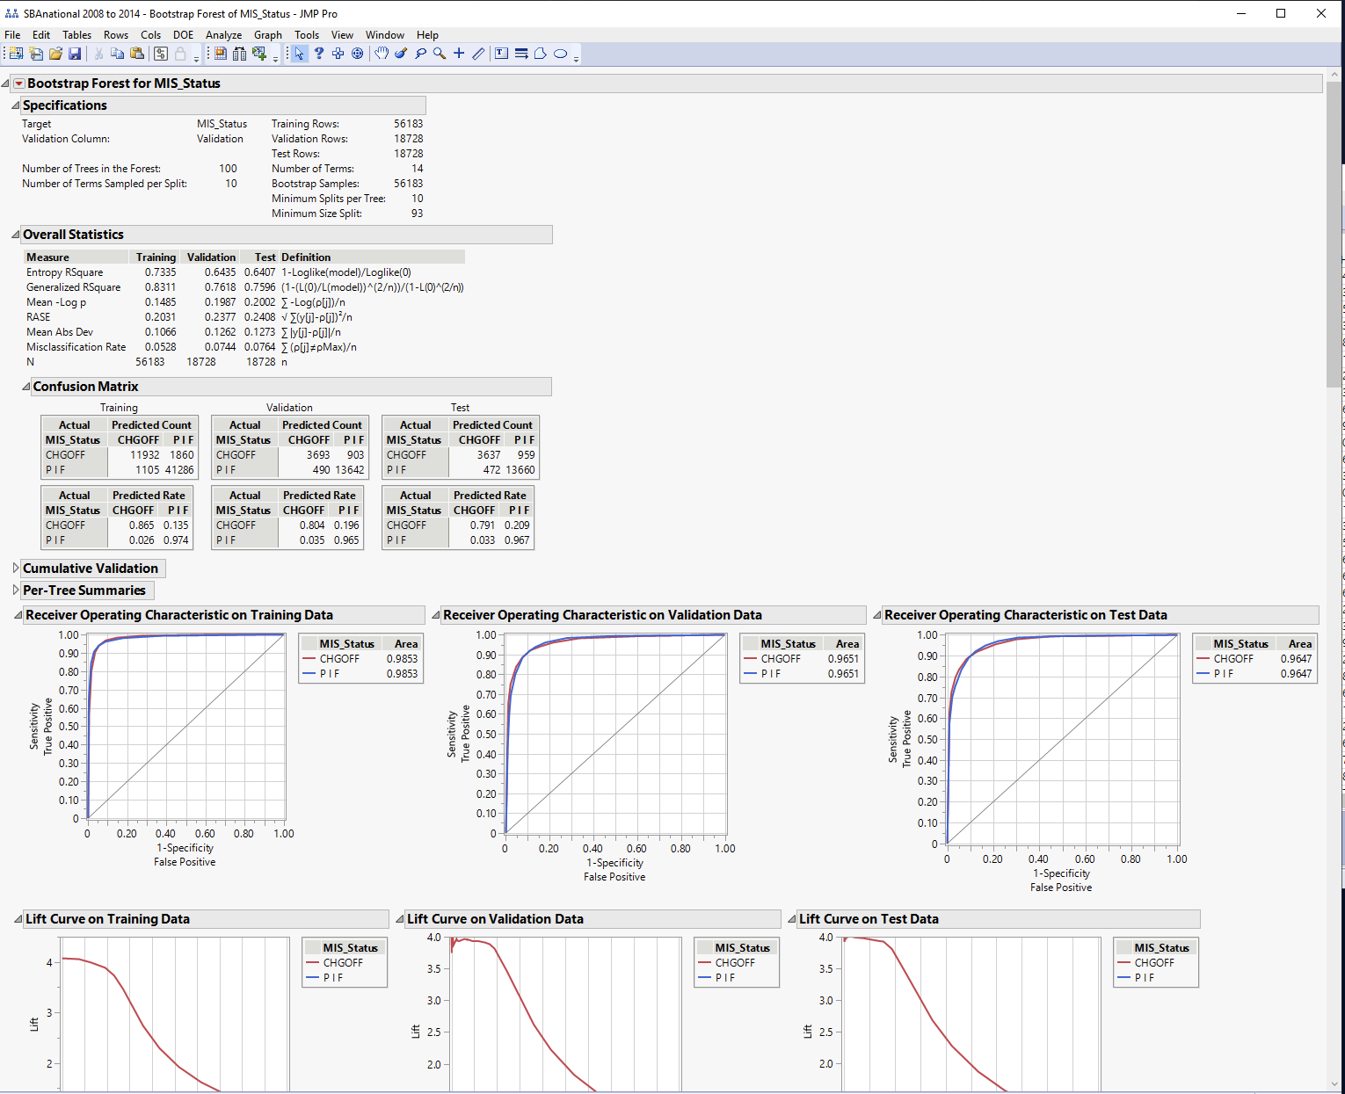
Best Model: Bootstrap Forest
Total Accuracy: ~97.08%
Accuracy of the 1 Prediction (Sensitivity): ~92.80%
Notes:
Bootstrap forest model aims to reduce variance by building multiple trees with random subsets of data. The final prediction is an aggregation of predictions from multiple trees, reducing the risk of overfitting. Our model has a total Accuracy of ~97.08% and the Accuracy of the 1 Prediction (Sensitivity): ~92.80% and it is also performing well on our Validation and Test data sets.

Slide 15
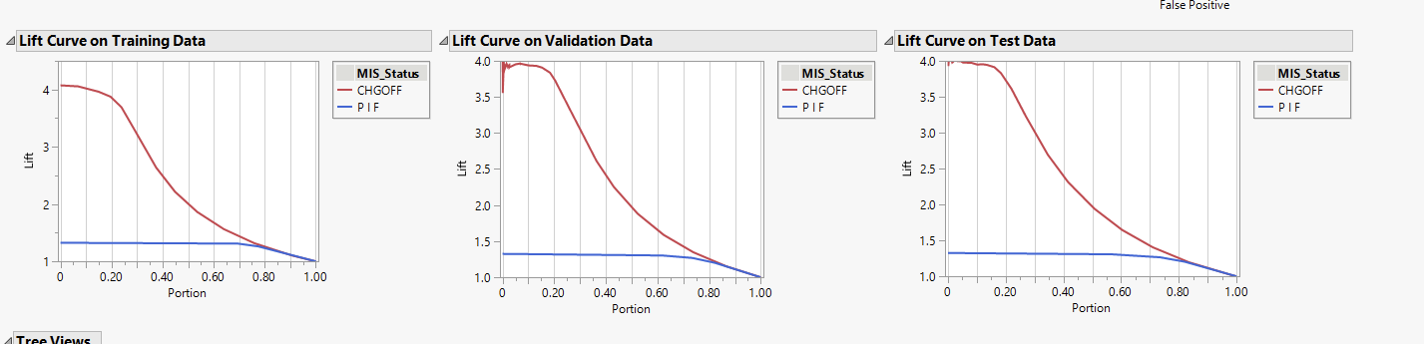
Best Model: Bootstrap Forest (Continued.)
Lift:
Training (30% portion): ~3.2
Validation (30% portion): ~3.0
Test (30% portion): ~3.0
AUC:
Training
CHGOFF: .9853
PIF: .9853
Validation
CHGOFF: .9651
PIF: .9651
Test
CHGOFF: .9647
PIF: .9647
Notes:
From the Lift curve, we see that we can have lift of 3 if we focus on top 30% of predictions.
Our AUC is also consistent with above 95% on all three data sets.

Slide 16
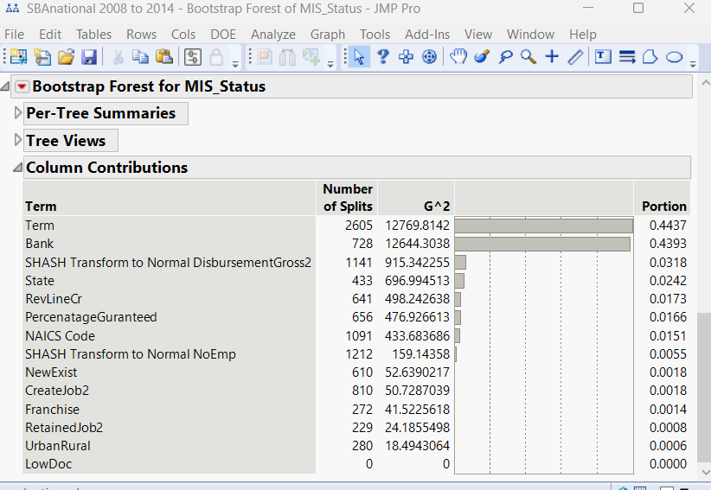
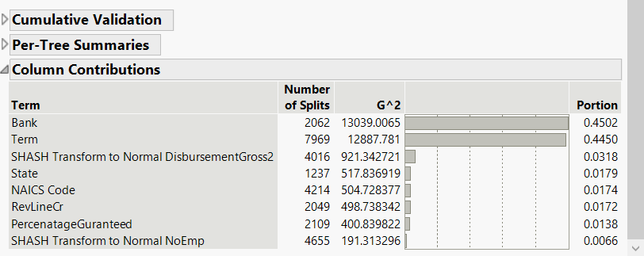
Best Model: Bootstrap Forest (Continued.)
Reducing Model Complexity
Column contributions in the initial model
Columns selected for the refined model
Notes:
We are now directing our efforts towards refining our model. Upon analyzing the column contributions, it's evident that certain columns exhibit minimal impact on the model's performance. Consequently, we've opted to reconstruct the model using a reduced set of variables that demonstrate the highest contribution.

Slide 17
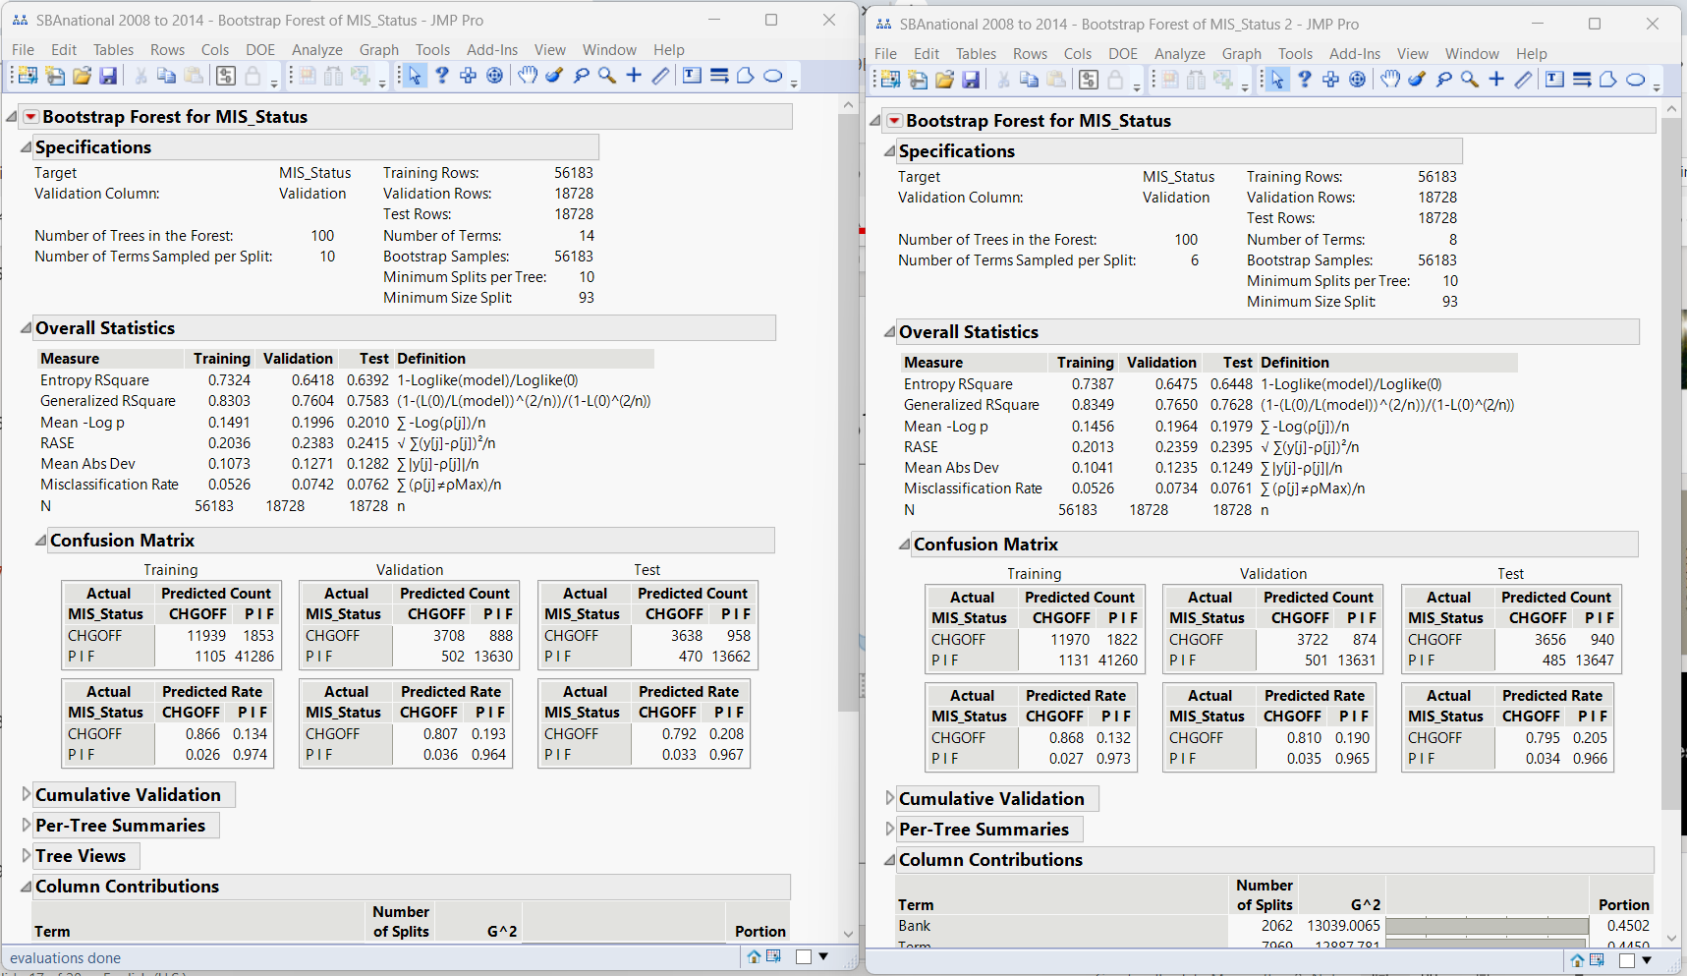
Best Model: Bootstrap Forest (Continued.)
Model Performance: Initial vs. Refined
Notes:
When comparing both models, we observed that the model utilizing fewer variables exhibits a relatively lower RMSE and has reduced misclassification rate. It is also maintaining our total accuracy and accuracy of 1 predictions.

Slide 18
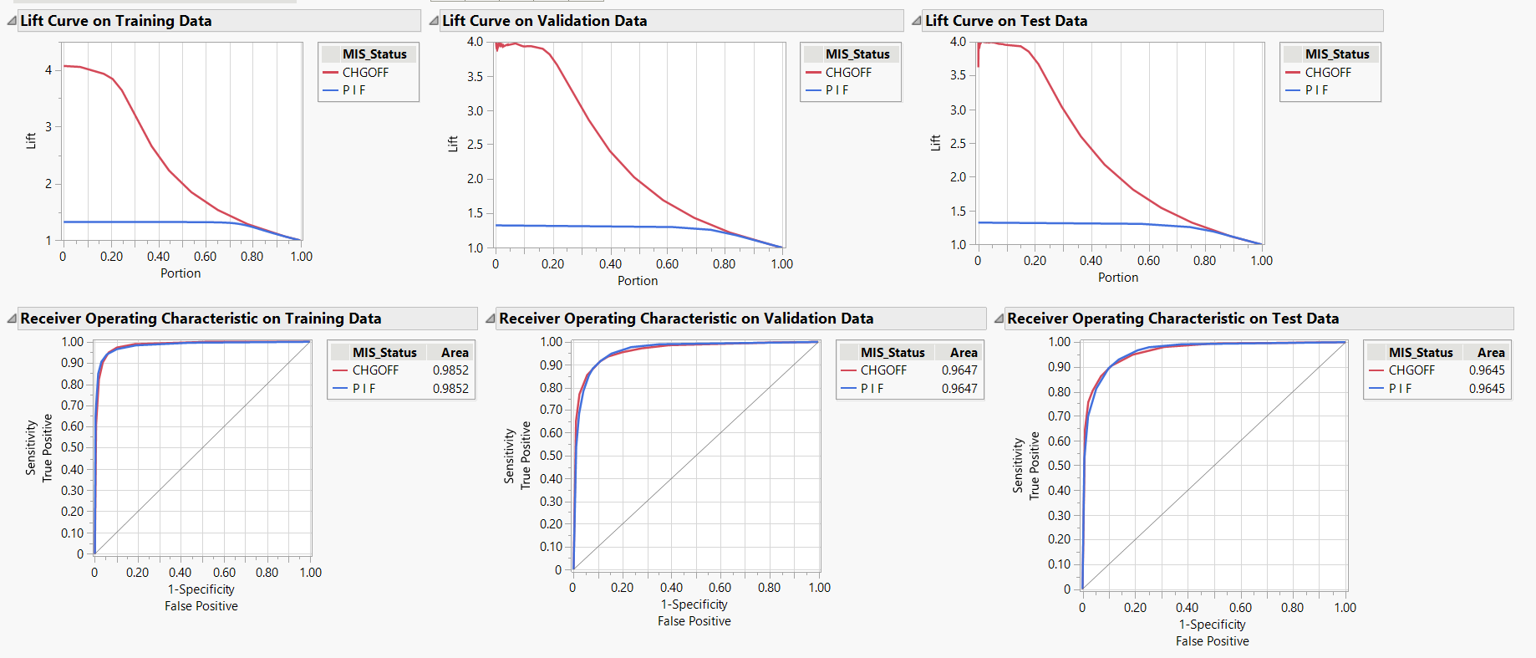
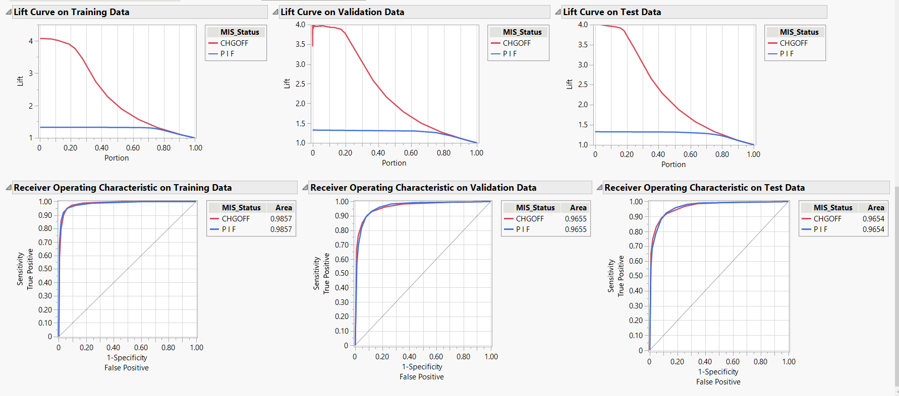
Best Model: Bootstrap Forest (Continued.)
No significant drop in the model's performance even with the reduced variables.
Our RASE & mis-classification further reduced for Validation and Test with improved AUC
Notes:
The AUC also slightly improved for both the Validation and Test datasets when employing a reduced number of variables in the model. This refinement has allowed us to achieve a more streamlined model without compromising its performance.

Slide 19

Exploring Cut-offs based on business value
In our endeavor to predict loan charge-offs, we consciously opted not to explore varying cutoffs based on business value during our model building process. This decision was made in alignment with our core commitment: prioritizing the support of small businesses over profit generation.
Notes:
In predicting loan charge-offs, we intentionally avoided exploring various business value cutoffs in our model creation. This aligns with our primary focus which is supporting small businesses over maximizing profits.

Slide 20
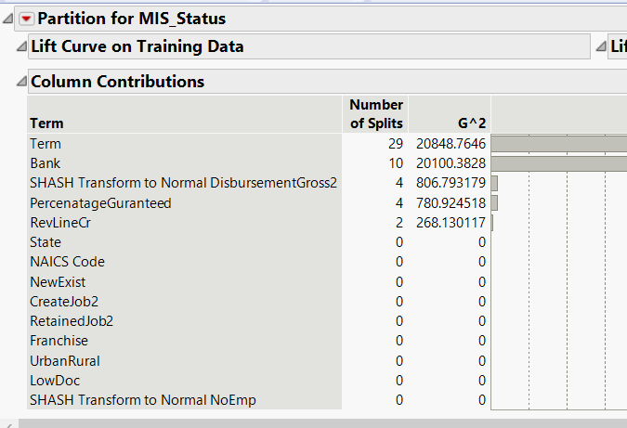
Trends and Patterns
The most influential variable across our top-performing models:
Loan Term
Loan provider Bank
Loan amount disbursed
Notes:
Across our best-performing models, we consistently observe that the columns for loan term, provider bank, and the loan amount emerge as the key contributors in model building.

Slide 21
Recommendations to the Business
To minimize the chances of CHGOFF status focus on:
Loan Term (prefer >= 60months)
Banks (List of banks with less CHGOFFs)
Notes:
Based on our analysis and the model's performance, we suggest integrating Bootstrap Forest model to access the loan charge-off. We also suggest, recommending small businesses seeking loans to consider opting for a loan term exceeding 60 months. Furthermore, we advise selecting banks with lower charge-off percentages, as they are more likely to offer flexibility in adjusting payment terms in case of potential repayment challenges.

Slide 22
Thank You!!
Notes:
Thank you for your time. Feel free to explore additional model statistics available in our Appendix slides.

Slide 23

Additional Model Statistics

Slide 24
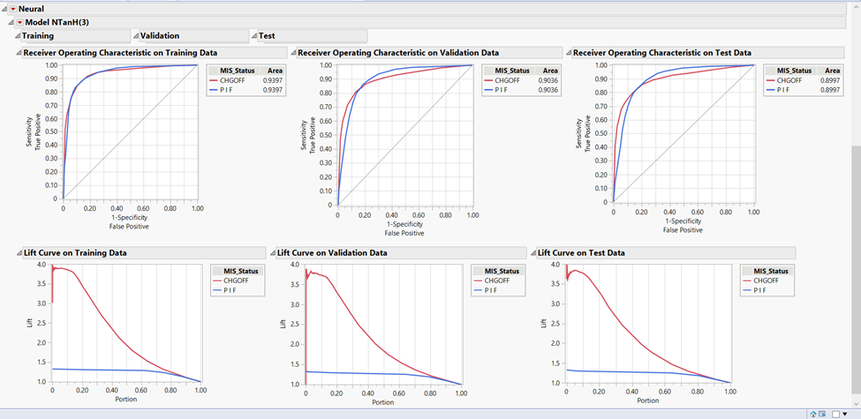
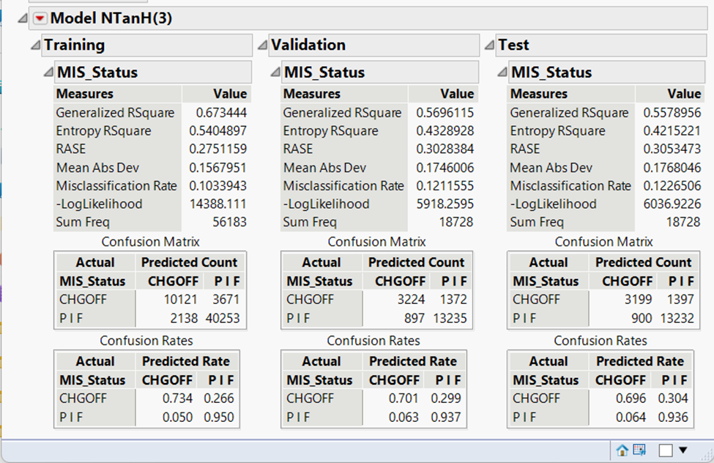
Neural Network Model
Total Accuracy: ~87.88%
Accuracy of the 1 prediction (sensitivity): ~78.23
Lift: Training: ~3.9
Validation: ~ 3.75
Test: ~3.75
AUC: Training:
CNGOFF & PIF ~ 0.9397
Validation:
CHGOFF & PIF ~ 0.9036
Test:
CHGOFF & PIF ~ 0.8997
Not as suffienct as other models

Slide 25
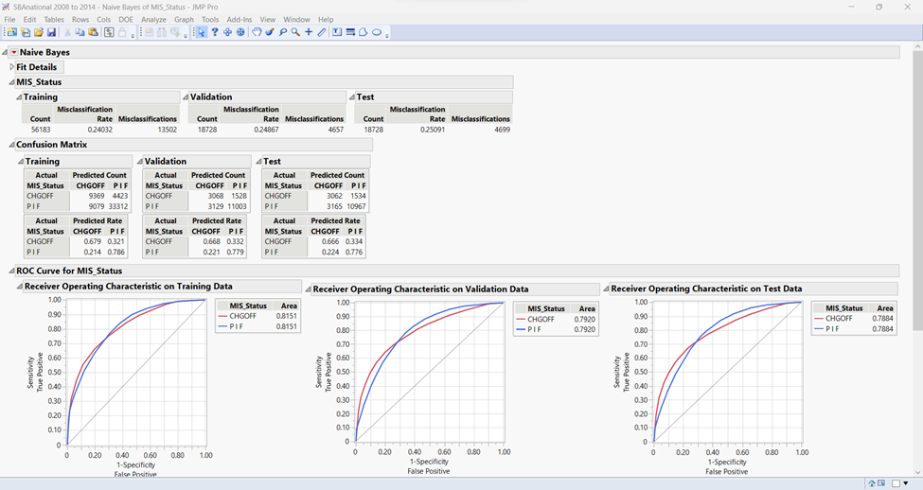
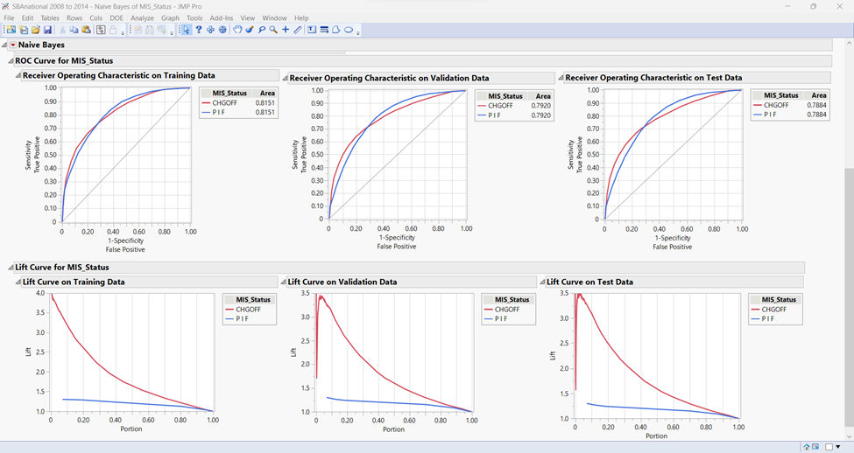
Naïve Model
Total Accuracy: ~74.9%
Accuracy of the 1 prediction (sensitivity): ~66.62
Lift: Training: ~3.9
Validation: ~ 3.45
Test: ~3.5
AUC: Training:
CNGOFF & PIF ~ 0.8151
Validation:
CHGOFF & PIF ~ 0.7920
Test:
CHGOFF & PIF ~ 0.7884
Not as sufficient as other models

Slide 26
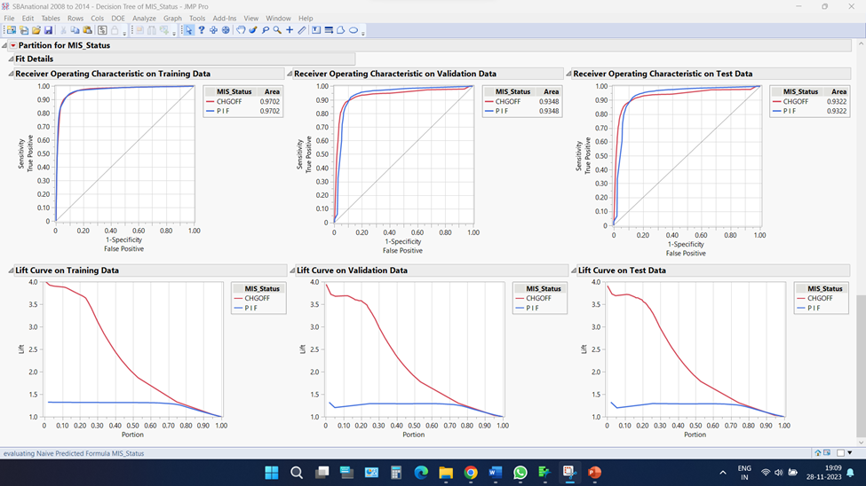
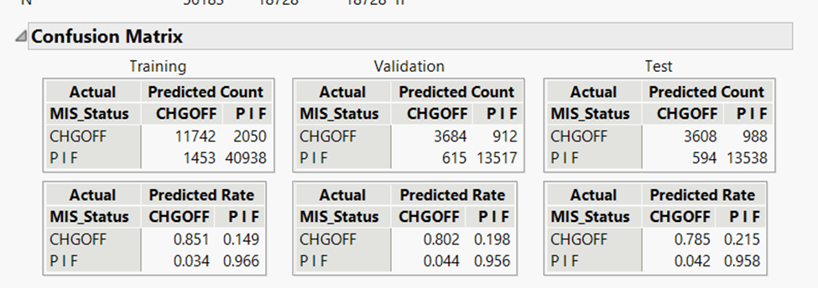
Decision Tree
Total Accuracy: ~98.29%
Accuracy of the 1 prediction (sensitivity): ~ 86.27%
Lift: Training: ~3.8
Validation: ~ 3.75
Test: ~3.75
AUC: Training:
CNGOFF & PIF ~ 0.9702
Validation:
CHGOFF & PIF ~ 0.9363
Test:
CHGOFF & PIF ~ 0.9228
Not as sufficient as other models

Slide 27
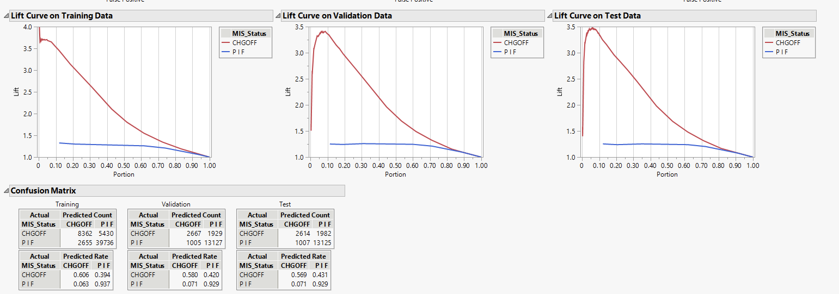
Logistic Regression
Total Accuracy: ~85.64%
Accuracy of the 1 prediction (sensitivity): ~ 86.27%
Lift: Training: ~2.60
Validation: ~ 2.50
Test: ~2.5
AUC: Training:
CNGOFF & PIF ~ 0.8999
Validation:
CHGOFF & PIF ~ 0.8638
Test:
CHGOFF & PIF ~ 0.8588
Not as sufficient as other models (long run time)

Slide 28
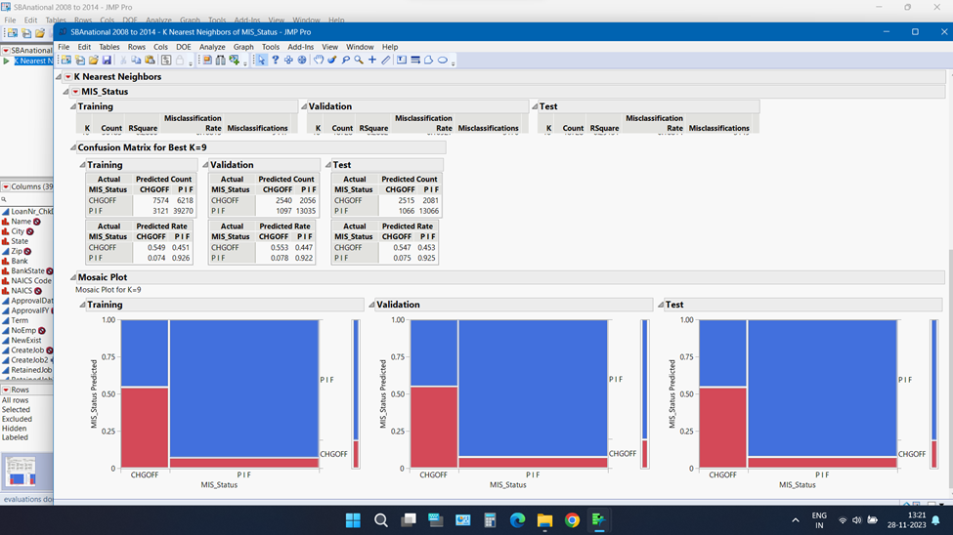
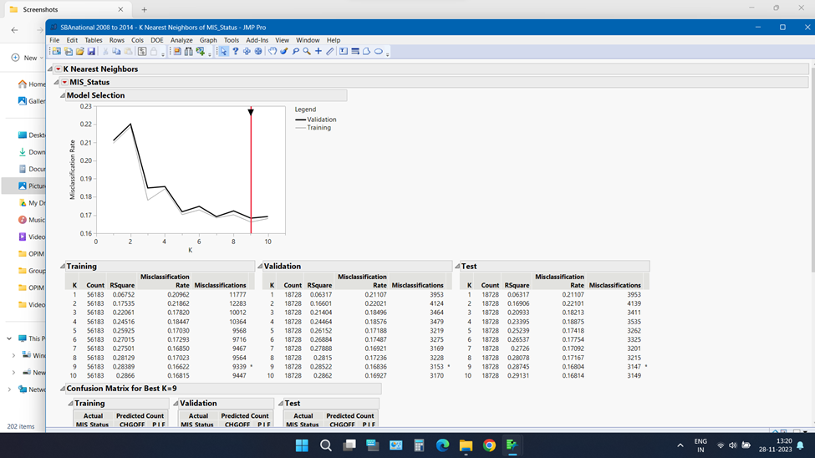
KNN Model
Total Accuracy: ~83.20%
Accuracy of the 1 Prediction (Sensitivity): ~70.23%
Not as significant as other models

Slide 29
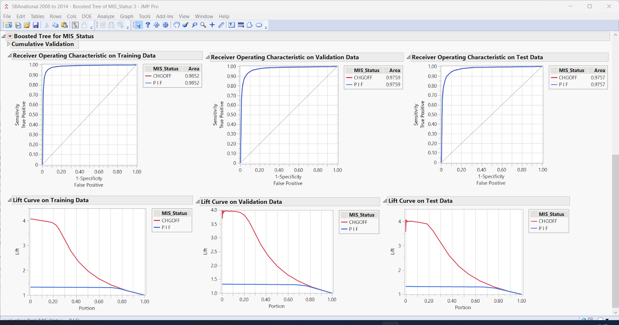
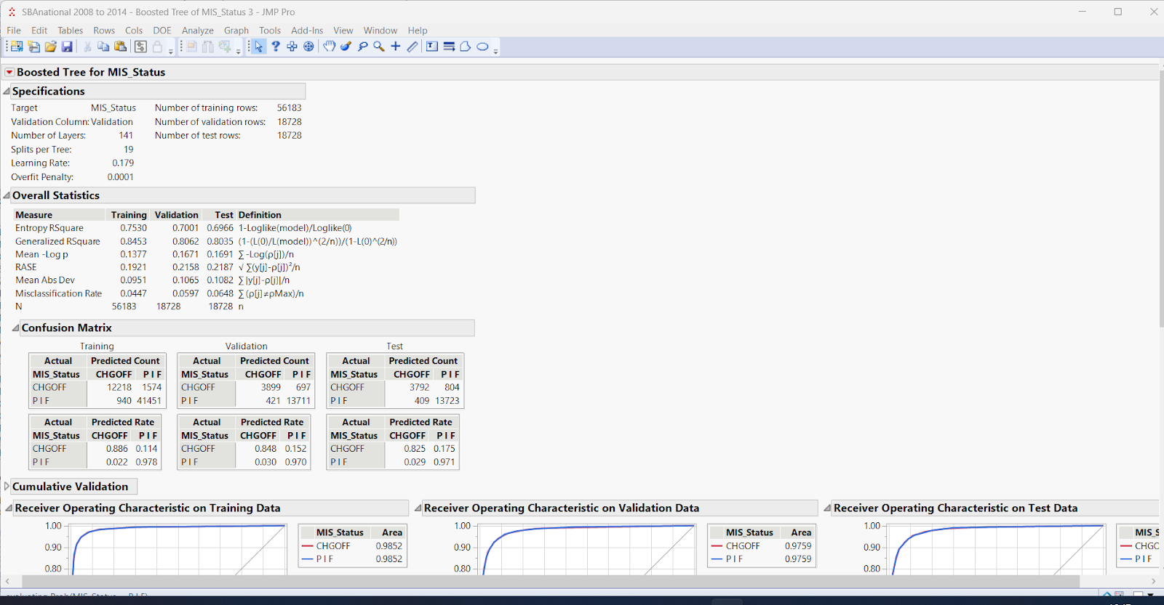
Boosted Tree
Total Accuracy: ~ 93.52%
Accuracy of the 1 prediction (sensitivity): ~ 90.26%
Lift: Training: ~4.1
Validation: ~ 4.0
Test: ~ 4.0
AUC: Training:
CNGOFF & PIF ~ 0.9852
Validation:
CHGOFF & PIF ~ 0.9759
Test:
CHGOFF & PIF ~ 0.9757
Not as sufficient as other models

Slide 30
References
The "SBAnational.csv" dataset from the U.S. Small Business Administration (SBA)
Class lectures

